Slide 1
Chap#3
Agile Development

Slide 2
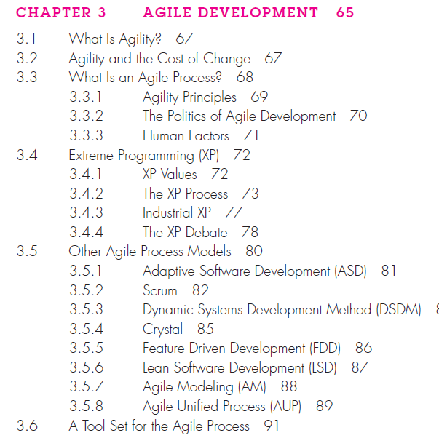

Slide 3
Introduction
Suggests revolutionary change that’s exactly what agile development is all about.
In essence, agile methods were developed in an effort to overcome perceived and actual weaknesses in conventional software engineering.
Agile development can provide important benefits, but it is not applicable to all projects, all products, all people, and all situations.
Market conditions change rapidly, end-user needs evolve, and new competitive threats emerge without warning. You must be agile enough to respond to a fluid business environment.
One of the most compelling characteristics of the agile approach is its ability to reduce the costs of change throughout the software process.
If process models are to work, they must provide a realistic mechanism for encouraging the discipline that is necessary.

Slide 4
3.1 What is Agility?
Changes in the software being built, changes to the team members, changes because of new technology, changes of all kinds that may have an impact on the product they build or the project that creates the product.
It encourages team structures and attitudes that make communication more facile.
It emphasizes rapid delivery of operational software and de-emphasizes the importance of intermediate work products.
Project plan must be flexible.
Working software to the customer.

Slide 5
3.2 Agility and the Cost of Change
The conventional wisdom in software development is that the cost of change increases nonlinearly as a project progresses.
It is relatively easy to accommodate a change when a software team is gathering requirements. The costs of doing this work are minimal.
An agile process reduces the cost of change because software is released in increments and change can be better controlled within an increment.

Slide 6
3.3 Agile software process
Any agile software process is characterized in a manner that addresses a number of key assumptions:
It is difficult to predict in advance which software requirements will persist and which will change.
It is difficult to predict how much design is necessary before construction is used to prove the design.
Analysis, design, construction, and testing are not as predictable as we might like.
How do we create a process that can manage unpredictability? Answer is agile process, therefore, must be adaptable.
an agile team requires customer feedback.
Software increments must be delivered in short time periods.

Slide 7
3.3.1 Agility Principles
satisfy the customer
Welcome changing requirements
preference to the shorter timescale
Business people and developers must work together daily.
Build projects around motivated individuals.
face-to-face conversation
Working software is the primary measure of progress.
Agile processes promote sustainable development.(Maintainence)
technical excellence and good design enhances agility.
Simplicity
self–organizing teams (best work done)
how to become more effective (constant work)

Slide 8
3.3.3 Human Factors
“Agile development focuses on the talents and skills of individuals, molding the process to specific people and teams.”
Competence (talent, specific software-related skills, and overall knowledge of the process)
Common focus(focused on one goal)
Collaboration(work together)
Decision-making ability(freedom)
Fuzzy problem-solving ability: Software managers must recognize that the agile team will continually have to deal with ambiguity and will continually be buffeted by change. In some cases, the team must accept the fact that the problem they are solving today may not be the problem that needs to be solved tomorrow. Lessons learned from any problem-solving activity may be of benefit to the team later in the project.
Mutual trust and respect
A self-organizing team is in control of the work it performs. The team makes its own commitments and defines plans to achieve them.

Slide 9
3.4 Extreme Programming (XP)
In order to illustrate an agile process in a bit more detail, I’ll provide you with an overview of Extreme Programming (XP).
XP targets the agile process specifically for use within large organizations.

Slide 10
3.4.1 XP Values
Set of five values that establish a foundation for all work performed as part of XP—communication, simplicity, feedback, courage, and respect.
Each of these values is used as a driver for specific XP activities, actions, and tasks.
Communication(informal (verbal) collaboration between customers and developers, important concepts, continuous feedback).
Simplicity (design only for immediate needs, rather than consider future needs, simple design, improvement)
Feedback is derived from three sources: the implemented software itself, the customer, and other software team members, user stories or use cases, unit test, acceptance tests)
discipline (courage) to design for today, recognizing that future requirements may change dramatically.
achieve successful delivery of software increments, the team develops growing respect for the XP process.

Slide 11
3.4.2 The XP Process
Extreme Programming uses an object-oriented approach. set of rules and practices that
Occur within the context of four framework activities: planning, design, coding, and testing.
Planning(requirements gathering, major features and functionality, user stories, priority,time,cost, work together, Project velocity(measure productivity))
Design(KIS (keep it simple) principle, guidance, extra functionality(discourage), organize, refactoring(optimize design, improvement ,less error))
Coding(implementation, pair programming(two heads are often better than one), details & standards of code, integration, unit testing, feedback)
Testing(unit tests, integration, validation testing of the system, XP acceptance tests, also called customer tests)
Figure 3.2

Slide 12
3.4.3 Industrial XP
“IXP is an organic evolution of XP. It is imbued with XP’s minimalist, customer-centric, test-driven spirit. IXP differs most from the original XP in its greater inclusion of management, its expanded role for customers, and its upgraded technical practices.”
IXP incorporates six new practices that are designed to help ensure that an XP project works successfully for significant projects within a large organization.
Readiness assessment(supportive environment, stakeholders, improvement, new values, broader project community)
Project community(Right people, well-trained, adaptable and skilled, success of a project, members and their roles)
Project chartering(appropriate business justification, how it complements, extends, or replaces existing systems or processes)
Test-driven management(state of the project and the progress that has been made to date, defines mechanisms for determining destinations)
Retrospectives(specialized technical review, issues, events, and lessons-learned)
Continuous learning(continuous process improvement, encouragement among members, learn new methods and techniques that can lead to a higher quality product)

Slide 13
Issues that continue to trouble XP
Requirements volatility(modified to accommodate current needs)
Conflicting customer needs(multiple customers, each with his own set of needs)
Requirements are expressed informally
Lack of formal design

Slide 14
Other Agile Models
Adaptive Software Development (ASD)
• Scrum
• Dynamic Systems Development Method (DSDM)
• Crystal
• Feature Drive Development (FDD)
• Lean Software Development (LSD)
• Agile Modeling (AM)
• Agile Unified Process (AUP)

Slide 15
3.5.1 Adaptive Software Development (ASD)
Technique for building complex software and systems. The philosophical underpinnings of ASD focus on human collaboration and team self-organization.
ASD “life cycle” that incorporates three phases, speculation(planning mission statement project constraints basic requirements time-boxed release plan), collaboration(Requirements gathering), and learning(components implemented/tested focus groups for feedback formal technical reviews postmortems).

Slide 16
3.5.2 Scrum
Scrum principles are consistent with the agile manifesto and are used to guide development activities within a process that incorporates.
Framework activities: requirements, analysis, design, evolution, and delivery.
15 minute daily meeting.
work tasks occur within a process pattern called a sprint.
Backlog—a prioritized list of project requirements or features that provide business value for the customer.
Team leader, called a Scrum master(leads the meeting and assesses the responses from each person, uncover potential problems, knowledge socialization, self-organizing team structure).
Demos—deliver the software increment to the customer so that functionality that has been implemented can be demonstrated and evaluated by the customer.

Slide 17
3.5.3 Dynamic Systems Development Method (DSDM)
Provides a framework for building and maintaining systems which meet tight time constraints through the use of incremental prototyping in a controlled project environment.
DSDM is an iterative software process(Rules follow).
Feasibility study—establishes the basic business requirements and constraints associated with the application to be built and then assesses whether the application is a viable.
Business study—functional and information requirements, basic application architecture, maintainability requirements for the application.
Functional model iteration—produces a set of incremental prototypes that demonstrate functionality for the customer & feedback from users.
Design and build iteration: Engineered in a manner that will enable it to provide operational business value for end users.
Implementation:(1) the increment may not be 100 percent complete or (2) changes may be requested.

Slide 18
3.5.4 Crystal
The name “crystal” is derived from the characteristics of geological crystals, each with its own color, shape, and hardness.
Resource limited, cooperative game of invention and communication, with a primary goal of delivering useful, working software and a secondary goal of setting up for the next game.

Slide 19
3.5.5 Feature Driven Development (FDD)
Describing an adaptive, agile process that can be applied to moderately sized and larger software projects.
(1) emphasizes collaboration among people, (2) manages problem and project complexity using feature-based decomposition, (3) communication of technical detail using verbal, graphical, and text-based means.
feature “is a client-valued function that can be implemented in two weeks or less”
small blocks of deliverable functionality, hierarchical, operational features, design and code representations are easier,Project planning, scheduling, and tracking are driven by the feature hierarchy.
Figure 3.5

Slide 20
3.5.6 Lean Software Development (LSD)
LSD process can be summarized as eliminate waste, build quality in, create knowledge, defer commitment, deliver fast, respect people, and optimize the whole.
(1) adding no extraneous features or functions, (2) assessing the cost and schedule impact of any newly requested requirement, (3) removing any superfluous process steps, (4) establishing mechanisms to improve the way team members find information, (5) ensuring the testing finds as many errors as possible, (6) reducing the time required to request and get a decision that affects the software or the process that is applied to create it, and (7) streamlining the manner in which information is transmitted to all stakeholders involved in the process.

Slide 21
3.5.7 Agile Modeling (AM)
(1) all constituencies can better understand what needs to be accomplished, (2) the problem can be partitioned effectively among the people who must solve it, and (3) quality can be assessed as the system is being engineered and built.
Agile Modeling (AM) is a practice-based methodology for effective modeling and documentation of software-based systems. Simply put, Agile Modeling (AM) is a collection of values, principles, and practices for modeling software that can be applied on a software development project in an effective and light-weight manner. Agile models are more effective than traditional models because they are just barely good, they don’t have to be perfect.
AM unique are Model with a purpose(Goal), Use multiple models, Travel light(Long term value addition, maintained as changes occur), Content is more important than representation, Know the models and the tools you use to create them(Strengths & weakness), Adapt locally(Adapt to the needs).

Slide 22
3.5.8 Agile Unified Process (AUP)
adopts a “serial in the large” and “iterative in the small”
phased activities—inception, elaboration, construction, and transition
Each AUP iteration addresses the following activities: Modeling, Implementation, Testing, Deployment, Configuration and project management(Change management), Environment management(Supportive technology).

